Slide 1
Business Intelligence G. Mudare

Slide 2
Special data types

Slide 3

Working with missing values
In R, missing values are represented with NA, a special data type that indicates the data is simply Not Available.
Never use ’NA’ as an abbreviation for anything (like North America).
Many functions can handle missing data, usually in different ways
In order to calculate the mean, we might want to either exclude the missing value or we might want mean(myvec1) to fail (produce an error).

Slide 4
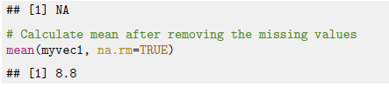
Working with missing values
The function is.na returns TRUE when a value is missing, which can be useful to see which values are missing, or how many,

Slide 5

Making missing values
In many cases it is useful to change some bad data values to NA by using indexes

Slide 6
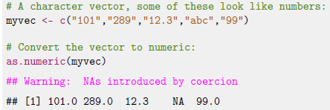
Making missing values
Missing values may arise when certain operations did not produce the desired result.
The warning message NAs introduced
by coercion means that missing values
were produced by when we tried to turn one data type
(character) to another (numeric).

Slide 7


Not A Number
Another type of missing value is the result of calculations that went wrong:
The result is NaN, short for Not A Number
Dividing by zero is not usually meaningful, but R does not produce a missing value:

Slide 8
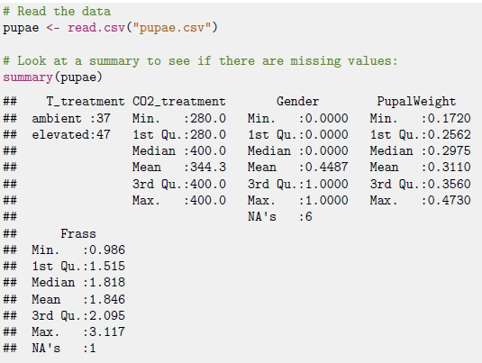
Missing values in dataframes
When working with dataframes, you often want to remove missing values for a particular analysis:

Slide 9
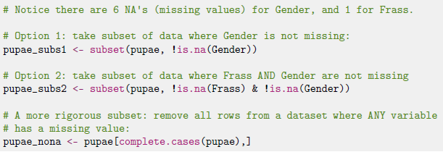
Missing values in dataframes

Slide 10
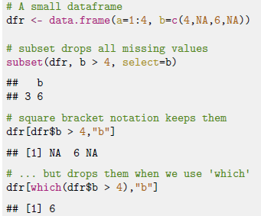
Subsetting when there are missing values
use which to drop missing values when subsetting

Slide 11
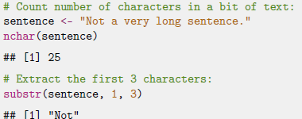
Working with text
Learn how to modify, extract, and analyse text-based (’character’) variables.

Slide 12
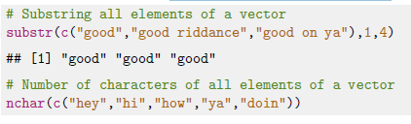
Working with text
When we have character vectors:

Slide 13
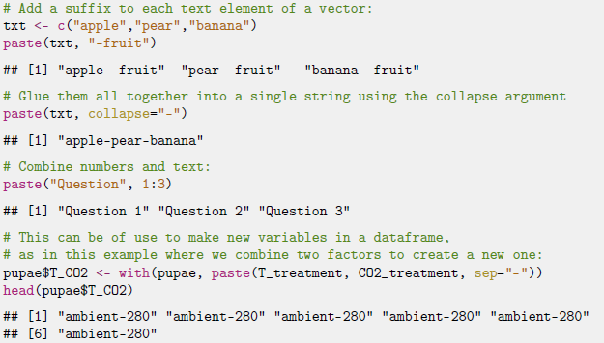
Working with text
To glue bits of text together, use the paste function, like so:

Slide 14
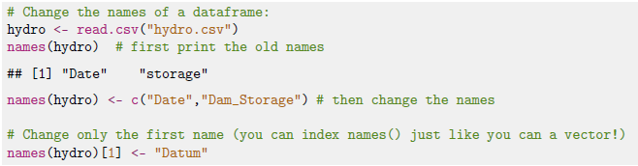
Column names
Vectors, dataframes and list can all have names that can be used to 1nd rows or columns in your data.

Slide 15

Column names
Sometimes it is useful to find out which columns have particular names→use the match function

Slide 16
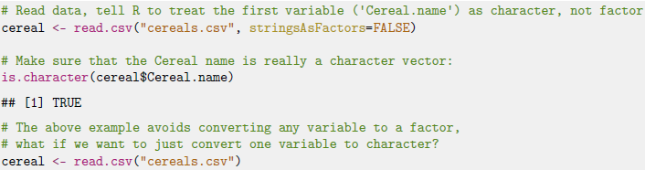
Text in dataframes and grep
When you read in a dataset (with read.csv, read.table or similar), any variable that R cannot convert to numeric is automatically converted to a factor. sometimes we want a variable to be treated like text

